Slide 1
Our biggest fears

Slide 2
Isolation

Slide 3
Message from Stu Webb

Slide 4
Yoga
Meditation
Exercise
Socializing

Slide 5
Working At home

Slide 6
Marketing

Slide 7
Technology tips and tricks
Communicate Changes to Client
Mailchimp
Cloud Based Programs – Fee Reductions?
Clio or Other Practice Management Software
Office 365 * Computer Virus Protection
Quickbooks Online
Communication with Client and Your Team
Telephone Forwarding or VOIP * Daily Firm Meetings
Zoom

Slide 8
Basics
Breakout Rooms
Sharing Screens

Slide 9
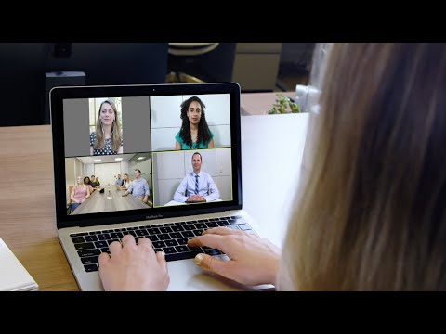
Preparing Clients for zoom

Slide 10
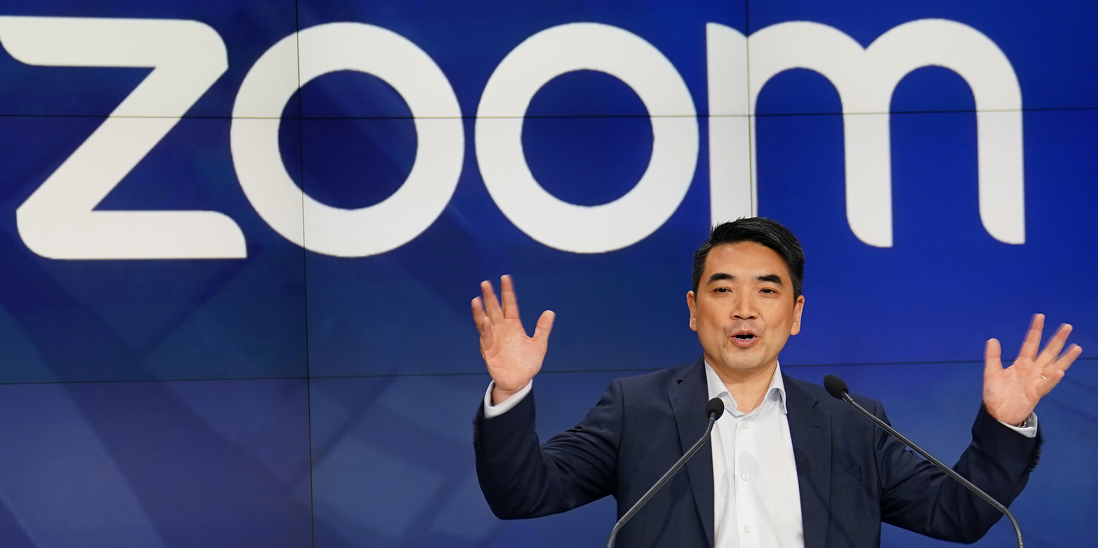
Understanding The Limits of zoom

Slide 11
Running meetings
Agendas
Prep technology
Debrief
Keeping minutes
Set time limits

Slide 12
What to watch in the evenings?
Relax…

Slide 13
IACP is here to help…

