Slide 1


INTRODUCTION TO COLLABORATIVE
PRACTICE
Notes:
Briefly introduce yourself – name, profession, member of IACP (who developed this slideshow), years in CP, connection to the audience

Slide 2

Ask your clients:
How do they want their children to tell
the story of their divorce?
Notes:
When you are consulting with clients seeking a divorce, what do you try to learn in your first interview? How would things change if you asked: How do you want your children to tell the story of your divorce?

Slide 3
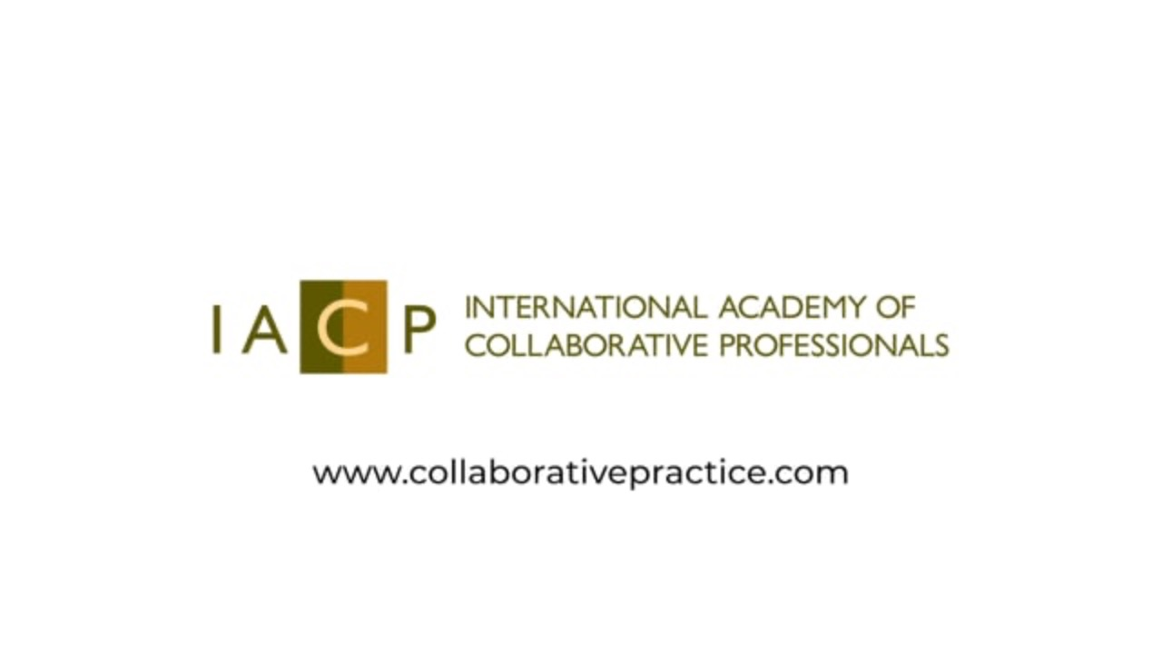
Collaborative Practice:
A peaceful way to restructure families
Notes:
This short video from IACP gives an overview of how CP works. I will explain more afterwards.

Slide 4
What is Collaborative Practice?
Collaborative Practice is a voluntary dispute resolution process in which clients create a durable agreement without resorting to litigation.
Notes:
Open with a short (2 min. or less) personal story about how you entered the CP community, or why you are convinced of its benefits.
In CP, the clients work together in a process that is transparent and in which all clients are informed of all relevant facts. Everyone agrees that the case will be settled out of court.
To enter the collaborative process, the clients and collaborative professionals must sign a Collaborative Participation Agreement.
As of the end of 2021, 23 states plus the District of Columbia have passed the Uniform Collaborative Law Act.

Slide 5

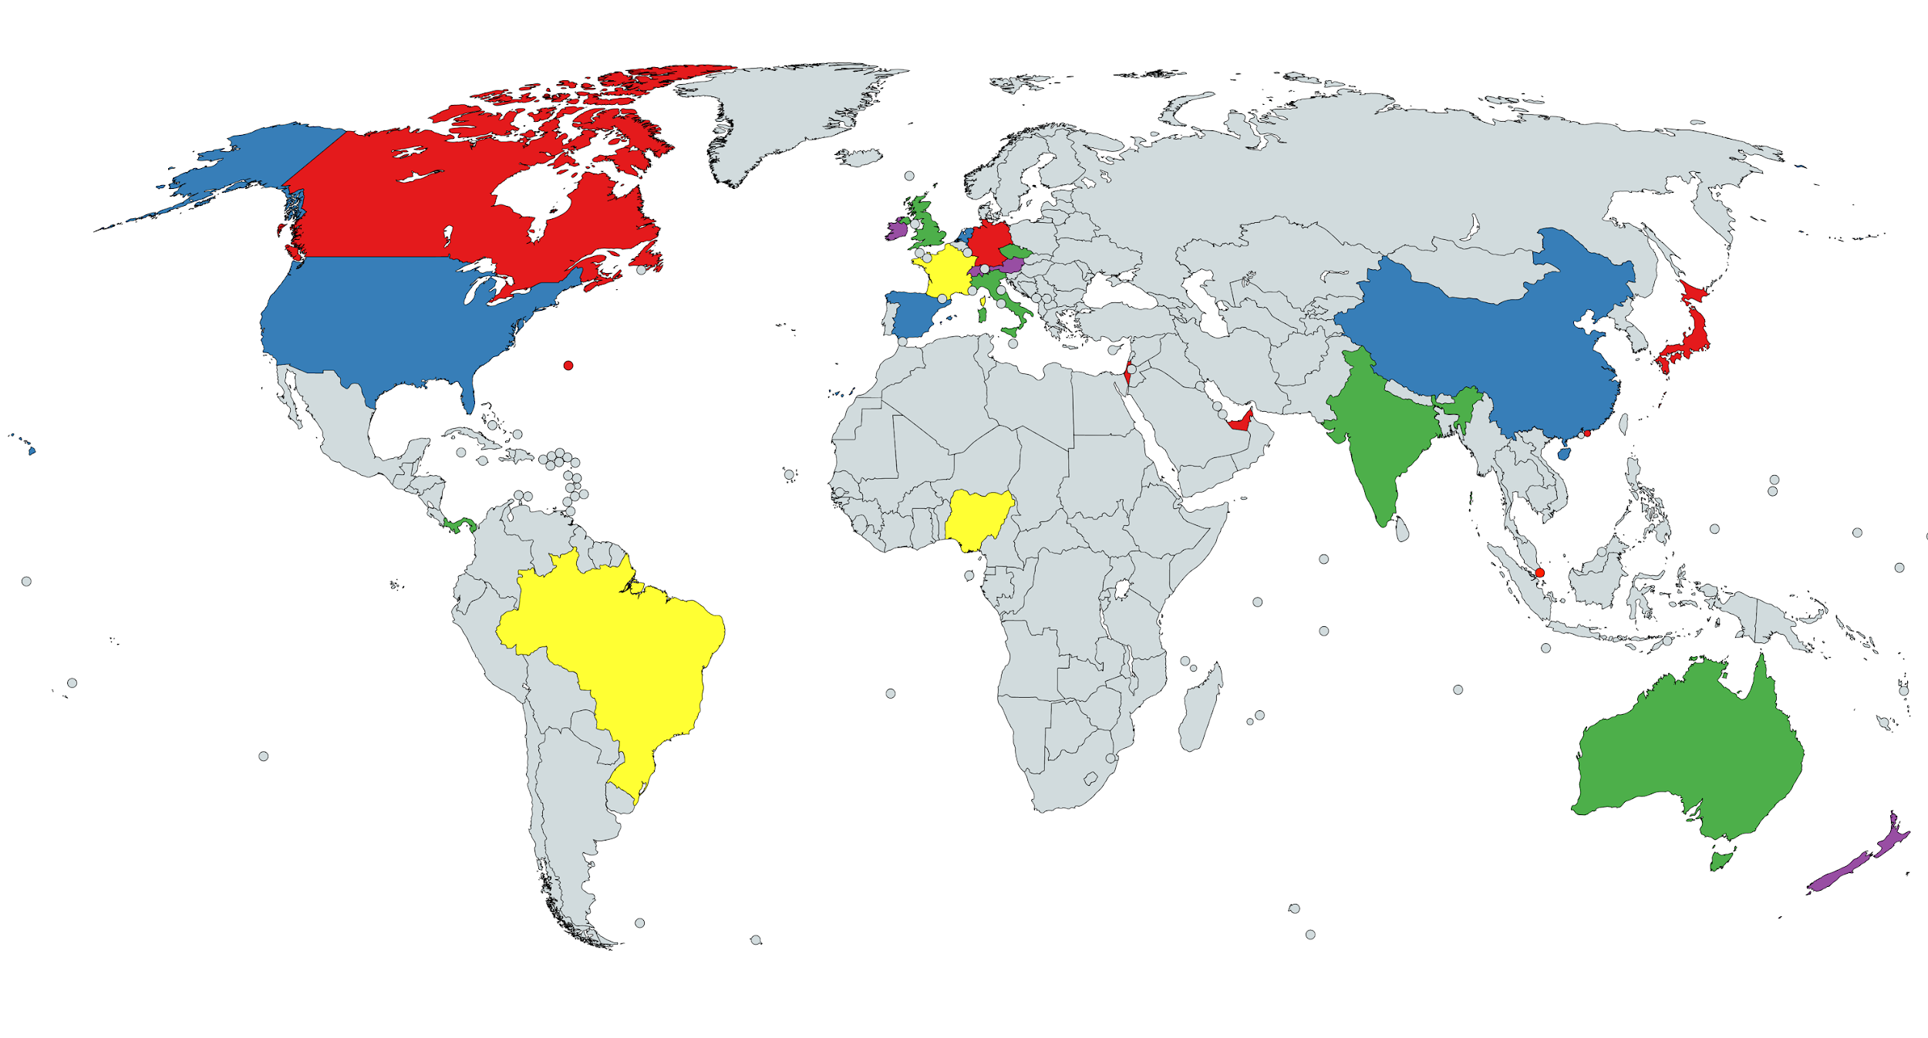

Countries with IACP members
Notes:
Collaborative Practice is offered in virtually all 50 states, all provinces of Canada, and 26 other countries on every continent except Antarctica.

Slide 6
A Team Process
Each client is represented by a Collaborative lawyer. The team often includes neutral professionals:
Mental Health Professionals, Child Specialists
Financial Professionals
Other Professionals and/or Experts as agreed
Notes:
Clients are always represented by Collaboratively-trained lawyers. The clients and their Collaborative lawyers may choose to add to the team neutral specialists with training in the Collaborative process. These neutral professionals have proven to be so beneficial that many Collaborative lawyers now only practice in full teams. Best practice is to have the neutral professionals join the Team at the start. But sometimes circumstances arise later in the process for which a neutral can be beneficial. Examples might be adding a business valuator or a child specialist, if concerns arise for which the expertise could be beneficial to the decision-making for the clients.
Collaborative divorces often begin when a client speaks with a Collaboratively-trained financial or mental health professional. Of course, many begin with a lawyer. Since separate representation is a critical part of CP, each must be represented by a lawyer in order to sign the Collaborative agreement that signals the beginning of a Collaborative case.

Slide 7

Defining Characteristics
Open and honest communication, with
full disclosure of information
Experts retained jointly
Commitment to resolving the dispute without litigation
Shared solutions through interest-based negotiations
Notes:
Honest Communication and Full Disclosure - Clients agree to disclose all relevant information. Professionals work as a team to identify what is needed and help the clients and each other obtain accurate information. Clients save money and time by avoiding a costly discovery process, and the commitment to transparency fosters trust in the team. For example, if a client is not easily able to discern what type of information is needed about his/her pension, one of the professionals may take on the task of communicating with the plan to be sure the clients and professional have the information necessary to make decisions. If a client hides financial information, the professionals have a duty to end the process unless the client will voluntarily correct the situation.
Neutral experts: Non-attorney professionals are neutral, and jointly retained. This increases trust, decreases conflict, and saves money that would otherwise be spent on hiring duplicate experts for both sides.
Resolution without Litigation: The commitment by all involved to stay out of court is a defining feature of CP. It applies to both clients and professionals.

Slide 8
Positional vs. Interest Based Negotiation
Positional Bargaining | Interest Based Negotiating
Clients are adversaries Demand/Entitlement based Argue individual fixed outcome Win/Lose focus | Clients are joint problem-solvers Needs/Concerns based Create mutually beneficial outcome Win/Win focus
Notes:
Interest-based negotiating underlies the Collaborative process. The goal of clients and team is to arrive at a workable and durable solution for everyone. Collaborative professionals know from experience that “winning” in court may not be a win in life. The shift from positional to interest-based negotiating is part of what Collaborative professionals refer to as the “paradigm shift” – a whole new way to approach helping clients.
Interest-based negotiations focus on the feelings, needs and goals of the clients themselves. Transformation can occur at the collaborative table. Transformative approaches focus on the quality of the relationship between the clients themselves.

Slide 9

Collaborative Lawyers
Represent Clients while maintaining the Core Principles of the Collaborative Process
Advise Clients regarding legal rights and responsibilities
Respectfully advocate for Clients through the Collaborative Process
Work with the Team to develop settlement options
Facilitate a final settlement agreement that serves the needs of the entire family system
Draft necessary legal documents
Ensure that agreements are finalized and approved by the Court
Notes:
Lawyers may be used to having a leading role in helping clients through a divorce, but the paradigm shift of Collaborative means they have a specific role as part of a team.
Maintaining Principles: Namely - 1) Open and honest communication; 2) Full disclosure of all relevant information; 3) Creation of shared solutions using interest-based negotiation; and 4) No Court
Respectful Communication: Language is important. Professionals try to use language that is neutral and non-judgmental and encourage the clients to do the same. E.g., “parenting time” instead of “visitation”; “support flow stream”, budget, or “cash flow plan” in place of “child support or spousal maintenance”. We try to ask open-ended questions, instead of questions that sound like a cross-examination. We try to avoid labels that we know might trigger a client, for example, we might say, “the ABC pension” rather than “Maria’s pension”.
Counsel Clients: We explain the relevant law to clients as one piece of relevant information they may wish to think about. We also provide clients with examples of how other families have resolved particular issues, to help illustrate a variety of options available. We help our clients understand and factor in the goals and concerns of the other client, and try to maintain balance between the “big picture” and “specific details”.
Creative Possibilities: Can open a discussion around empowering clients to consider solutions that are beyond “the shadow of the court”, by which we mean what the court would likely do if the case were before a judge. Clients are free to craft creative or personalized solutions that fit the needs of their family. This can be especially important for non-traditional families, or families from underserved communities. The “paradigm shift” requires a lawyer to let go of outcomes a court would want and avoid hijacking the team’s process to align with positional goals. Each lawyer will do the work to prepare the client for meetings and prepare the team for the client. Lawyers assist the clients in identifying their high-end goals and communicating these openly. lawyers check in with the client and relay any cause for concern or potential challenges between the clients to the other team members as quickly as possible. Regular check ins are vital. Professionals should strive for open communication with each other. However, it is important to guard the confidentiality of these professional team communication to avoid the possibility of inflaming the clients’ emotions.
Team-based Approach: Rather than the lawyer-centric process of litigation, Collaborative is a team-based approach in which the mental health professional and financial professional are full team members. As part of the lawyer paradigm shift, it is necessary to learn to power-share with the other professions so that their expertise and skills become an integral part of the process.
Lawyers in a collaborative process are able to build a rapport with the “other” client and get to know the “other” client. This helps tremendously in terms of building empathy and understanding for both of the clients in the room. The idea is to operate as “we” instead of a mentality of “us and them”.

Slide 10
Mental Health Professionals
Process Facilitator/Coach:
Can lead Team Meetings
Craft Parenting Plan with the clients
Assess & manage communication dynamics between the clients and the Collaborative Team
Support emotional needs
Help clients to focus on concerns and interests of the entire family
Notes:
In some communities, there are two mental health professionals, one for each client. In others, there is one neutral MHP. The mental health professional will remain neutral and hold the emotional needs of both clients and assist the entire team in the event of “splitting”, a phenomenon in which professionals begin to take sides. The team members can then remain unified and not allow the demonization of any client or team member.
Communication Dynamics/Emotional Content - In full team meetings, various team members may be tasked with leading the meeting. Sometimes having a neutral professional lead provides a tone and presence which allows challenging discussions to flow in a more harmonious way. Their professional training can help to facilitate productive discussion. Coaches can work with clients individually to help them prepare for group meetings. They may assist a client in remaining calm in the event strong emotions are triggered. They may help clients to express concerns in a mindful manner, ask for breaks, address deeper needs, etc. Coaches sometimes work with the couple without the lawyers present, for example, to discuss parenting issues or how to talk about the separation with friends and family. All of this can save clients time and money, as well as lessen their emotional distress.
Focus on What’s Important - Coaches can help clients identify their own priorities and goals. Clients are often inundated with advice from well-meaning friends and family and a coach can help a client keep outside advice in perspective. Emotional ups and downs sometimes impact each client’s ability to remain focused on their highest goals, and at those times, a coach can work with the client to help him/her maintain focus. Often, focusing on the needs of any children can help to reduce conflict between the couple.

Slide 11
Mental Health Professionals
Child Specialist:
Give children a voice with a focus on identifying needs
Provide information on children’s developmental needs
Guide parents in reaching an agreement that addresses the
children’s needs
Notes:
Give Parents Information - often parents are more receptive to considering information and/or feedback from a neutral child specialist than one of the collaborative lawyers or from each other. For example, if a couple is struggling to find the right parenting schedule for a toddler, a child specialist might be able to provide information relevant to a toddler’s developmental and idiosyncratic needs, which the parents can then consider when making their schedule. The key is that the information is provided by a professional who is not aligned with one client or the other.
Help Negotiate Parenting Plan - in some jurisdictions parents will work with the child specialist on their parenting plan, with the clients and child specialist checking in with the lawyers only as needed, rather than having the lawyers in the room. There are two benefits to this: the child specialist is better suited to working on parenting plans, and this arrangement saves money for the clients.

Slide 12
Financial Professionals
Efficiently gather and organizes all financial information
Educate clients and team
Illustrate client options
Lead financial option generating and analyses
Focus on outcomes
Notes:
Financial neutrals can help support the process in many ways, e.g., by:
-facilitating the financial decision-making meetings in careful coordination with the Coach (who continues to attend to the emotional and communication dynamics that come into play)
-neutral assessment of financial data needed to support the questions the clients want answered and the decisions they need to make versus generic discovery that may ask for unnecessary information and fail to request information that actually helps the team, including the clients, better understand and resolve the financial concerns of the family.
-setting reasonable deadlines for gathering data
-assisting the clients in obtaining information when they are not able to do so on their own
-helping the team to keep our facts straight and effectively using reporting tools to assist the team, including the clients, to distill financial information so the information is easily understandable and accessible
-identifying the most useful amount of data needed (e..g, one year’s tax return may not be at all sufficient to understand a couple’s past and projected incomes)
-provide analyses and explanations to help the team better understand the financial or tax consequences of specific decisions under consideration (e.g., tax on a the sale of a rental home)
-prevent a decision from creating an unintended post-divorce financial or tax consequence
-help maintain a “neutral” approach in and out of the meetings
-helping clients to feel that they are equally well-informed in the process; support is especially important for the spouse who has not been involved in managing the finances

Slide 13
Other Professionals
Examples include:
Tax Accountants
Business or Estate Lawyers
Real Estate Professionals and Appraisers
Financial Planners
Mortgage Lenders
Credit/Debt Counselor
Medical and/or Mental Health Providers for the clients or the children
Notes:
Most often these professionals are engaged jointly, and the information they provide is shared with the entire team. However, the team can determine that only one client has need of specific services in order to be well informed. For example, one client may need to consult with a mortgage lender to better understand how or if they might qualify for a mortgage post-divorce.

Slide 14

Benefits of the Collaborative Process to the Clients
Constructive, respectful approach that values and preserves relationships
Reduces conflict and stress on family
Simplifies sharing of information
Creative solutions driven by client needs and interests
Allows clients to preserve privacy
Clients control pace of process
Plants seeds for healthier post-conflict relationships
Notes:
Simplifies Sharing of Information - Collaborative eliminates formal discovery and the need for clients to each hire their own expert witness to provide information about asset values and/or tax concerns. One expert or accountant is retained to provide neutral opinions and advice.
Privacy - most couples using the collaborative process never have to step inside a courthouse.
Collaborative professionals can help the clients have conversations that would not happen in a different process because they are not based in the law, but that might be key to overcoming impasse. For example, one client may need to hear the other offer an apology for a bad behavior. That simple vulnerable act might help the recipient shift emotionally and be better able to understand the perspective of the other client and achieve compromise.

Slide 15
Collaborative is NOT Mediation
The Team Members:
Ask questions, share information, brainstorm, evaluate alternatives and offer ideas
Are actively involved in the decision-making process
Engage in “real-time” creative problem solving
Address impediments to settlement together
Equally share the common goal of peaceful resolution
Notes:
Under the Collaborative Participation Agreement, clients have assurance that the collaborative professionals will not suddenly file court papers; in a traditional mediation setting clients do not have that same assurance.
In CP, each client is represented by their own lawyer.

Slide 16

Collaborative Practice Allows Clients to:
Maintain their privacy
Control the pace of the process
Value intangible interests
Focus resources to create best outcomes
Receive support based on specific family needs
Notes:
Control: clients are not bound by court deadlines and can reach creative solutions, meaning they can opt for outcomes that would be outside of the scope of what a court could or would do. The clients bring their own solutions with the assistance of the team.
Intangible Interests - The Collaborative Process is arespectful and dignified way to resolve conflict. It preserves and restores good will. The professional members of the team regularly model good communication and problem-solving skills for the clients. This helps them do the same in decision-making conversations and hopefully in their relationship beyond the divorce process. This is especially helpful for co-parenting.
Emotional containment means to support and facilitate healthy power and communication dynamics: providing space for emotion without allowing those emotions to drive or otherwise overtake the process.
Pace/thoughtful choices - divorce litigation frequently ends with the clients settling on the morning of trial, under immense pressure with little time to consider important details. The collaborative process provides the time necessary for all decisions to be carefully considered.

Slide 17
Cases Suitable For Collaborative
Prenuptial/Postnuptial
Divorce
Paternity/Parentage
Modifications
Enforcement
Domestic violence issues
(special considerations/safeguards in place)
Notes:
The Collaborative container can hold all degrees of complexity and conflict. It is not necessary for clients to get along to participate in the Collaborative process. Some of the most satisfying cases can be in working with high-conflict families and helping them find a path for de-escalation and ultimately peaceful resolution.
All levels of complexity can be addressed, with a sufficiently experienced and qualified team.

Slide 18
Clients Suitable for Collaborative
Clients:
Dealing with challenging issues or imbalance of knowledge
Who want to maintain privacy
Who want to preserve good will
Who want to remain connected to each other’s friends, family, and professional networks
Unable to reach high-quality settlement on their own
Notes:
Families with Children: Minor and also adult children. The collaborative approach maximizes the chance that both parents will be able to share important life events. We often ask what it would be worth to dance at your child’s wedding.
High Quality Settlement: Some couples present with a high degree of cooperation and motivation, but need assistance to properly understand and address the issues they must address, for example: rental properties, what to do about a family owned business, or how to divide a pension.
Privacy: In most jurisdictions, collaborative clients never need to enter the courthouse to complete their divorce.
Challenging issues can include addictions, unhealthy power imbalances, and even domestic violence as long as both clients are willing to grapple with those issues head on with the support of a team of well-trained professionals. The collaborative process provides support and containment for even the most challenging issues in the way the court cannot. To operate at this level requires an experienced and highly functioning collaborative team.

Slide 19

Benefits of Collaborative
Practice for Professionals
Provides time and space for thoughtful,
creative, high-quality work product
Less stress/greater satisfaction
Greater ability to set work schedule
Fosters the development of satisfying
relationships with other professionals
Deeply satisfying case outcomes for
clients and professionals
Professional fees are paid (no collections)
Notes:
The practice of law is often stressful and prone to conflict and anxiety. Lawyers become inured to outcomes where at least one client, and often both, are deeply disappointed in the outcome. The paradigm shift allows lawyers and the professional team to focus on win-win solutions. Collaborative practice allows professionals to support each other, rather than engage in one-upsmanship, and to free themselves from the constraints of past cases that were decided based on complicated and inconvenient fact patterns. The lawyer can ask the client “What do you want to do” and then focus on a way to make that happen. Most of us got into the practice of law because we wanted to help people. Collaborative practice is deeply satisfying for these lawyers.

Slide 20

How to become a Collaborative Professional
Introductory Collaborative Training
40 hours of mediation training
Join a practice group
Other requirements in the IACP Standards and Ethics
Notes:
Professionals licensed in the core professions start the process of becoming a Collaborative Professional by completing an Introductory Training (often 2 days)
40 hours of mediation training is also required
Collaborative professionals practice in teams, so it is necessary to work with others who are Collaboratively trained. Most Collaborative Professionals are part of local practice groups who work together and support each other. You can find practice groups in your area on the IACP website, or if there are none, you can start your own! IACP has resources for new practice groups and professionals who want to get started in CP.
Other requirements to be a Collaborative Professional are available in the IACP Standards and Ethics, available on their website.

Slide 21
International Academy of Collaborative Professionals
www.collaborativepractice.com
Notes:
The IACP website offers information about introductory training, a find-a-professional database for clients, a practice group database, a community event calendar, and many other resource about Collaborative Practice.
Any questions?

