Slide 1
Saving the Golden Goose: How Family Run Businesses can Survive and Thrive after Divorce

Slide 2
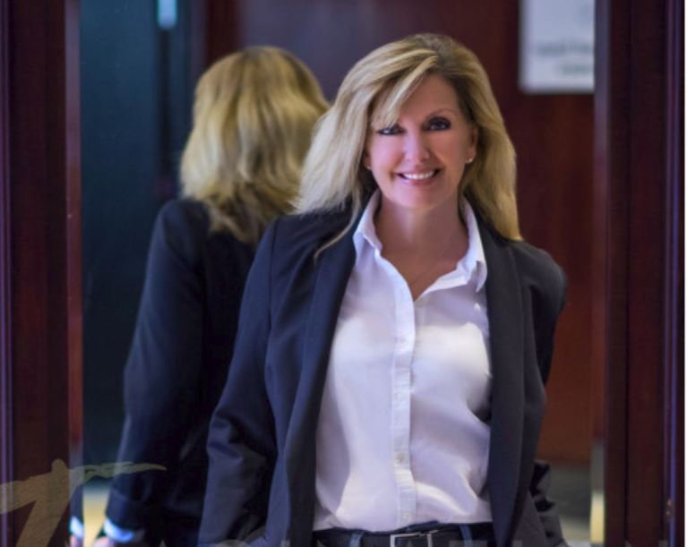
Carrie Heinzl HBSc, CDFA
Financial Neutral & Divorce Settlement Expert
Collaboratively trained level I & II
Member of the Law Society of Ontario
Member International Divorce Financial Analysts
Board of Directors - York Collaborative Practice
Member Durham, Kawartha, York & Toronto Collaborative Practice

Slide 3
Jason Kwiatkowski CPA, CA, CBV, ASA, CEPA
Chartered Business Valuator with 20 years of experience
Financial neutral - specialist called in to deal with situations involving a business interest
Collaboratively trained (level I & II)
Business Valuation – property for equalization purposes
Income Assessment – income for support purposes

Slide 4
Russell Alexander HBA, LLB
Called to the Bar by the Law Society of Ontario in 1998
Dedicated practice to achieving results using compassion, collaboration and client-focus
Dedicated to Family Law & Related matters, including custody, spousal support, child support and divorce
Focus on private custom resolutions
Active Member of Kawartha, Durham and York Collaborative Practices

Slide 6
Just so you know …
Case studies discussed are based on collaborative practice cases from Ontario, Canada
Support, property sharing/ division, tax, estate implications, Rules and Procedures may vary from the ones discussed in this presentation

Slide 7
Why Collaborative Thrives for Family Run Businesses…
Collaborative Practice offers an effective alternative to the inherently adversarial court process.
Both parties must enter into the process voluntarily, and agree to resolve their issues respectfully.
Collaborative process allows the parties to generate options that best suit their family and consider a much wider constituency of ‘concern’ represented by family members and other stakeholders.

Slide 8
Key Elements …
Collaborative practice is the voluntary sharing of full and frank disclosure amongst the parties. When placed in the family business context, this is especially crucial.
Spouses must remain willing and open to discuss the issues, while firmly planted on a foundation of financial disclosure.
Settlement will be based on the assumption that the parties have acted in good faith and have provided complete and truthful information prior to settlement.

Slide 9
How can we save the Golden Goose?

Slide 10
Collaborative offers ...
Privacy
Tax Planning & Corporate Share structures
Flexible payment structures
Increased corporate health protecting income & capital

Slide 11
We ensure ...
Insurance is in place to cushion risk affects
Succession planning & family legacy
Managing continued income streams
Income splitting
“If & when” scenarios for sale of business
Acknowledging market and business patterns

Slide 12
Alternative options ...
Family trusts & Holding Companies
Tax Planning – avoiding audits
Employment of spouses and children
Estate, succession & capacity planning

Slide 13
Our Roles …

Slide 14
The Financial Professional …
Power of Neutrality
Client & Advisor Education
Financial Disclosure experts
Early Warning Capability for Clients & Advisors
Disclosure Preparation, Analysis & Presentation
Ongoing Management of Expectations
Continuous Financial Analysis of Options & Approaches
Document and Report preparation
The Next Chapter … the new Operating Model

Slide 15
Private Settlement Benefits…
Maintain privacy
Preserve family legacy/wealth/relationships
Creative approaches – No two families or business are the same
Pacify other Stakeholder/Legacy Interests
Tax planning
Appropriate allocation of Risks and Rewards
Increase options for settlement
Maintain goals & interests of clients and their family members

Slide 16
Things to consider …
Barometer of the family
Structure of the Agreement
Duration of the Agreement
What other Agreements need to be put in place?
Wills?
Shareholder Agreements?
Pre-nuptial/ Co-habitation?

Slide 17
The Business Valuator…
Educating the clients on process
Preparing written reports (BV, Income Assessment)
Oral reports / verbal communications
Big picture review – is there likely value?
Investigate and report on a specific issue
Attend collaborative team meeting and assist with “option generation”

Slide 18
Private Settlement Benefits …
A family business can be the major source of funds/lifestyle for a family
Traditional litigation can be time consuming and costly
Family financial resources can be depleted very quickly
The family business can be put at risk:
Lack of effort/focus from owner
Forced sale/liquidation for below market price
Public record and risk of CRA audit

Slide 19
Things to consider …
The collaborative process can work – even in high conflict matters
Critical to understand company structure and share ownership:
Sole proprietorship, partnership, corporation
Sole shareholder, jointly owned or owned with other family members
Are there trusts, holding companies?

Slide 20
The Reports …
Written Reports:
Business Valuation - Calculation, Estimate, Comprehensive
Limited Critique Reports
Expert Reports – Income Assessments
Must be in accordance with CICBV professional standards
Takes additional time/cost to prepare the written report
Verbal Reports:
Professional standards do not apply
Level of review and analysis is the same
Time and cost is saved by not preparing the report
Meet with parties to present process, scope of review, assumptions and findings
Address specific concerns / issues / questions
Can take notes but cannot keep schedules

Slide 21
The Reports …
Big Picture Review
Discussion and high level review
personal v. commercial goodwill)
preliminary review: is worthwhile to have a full blown valuation report prepared?
Detailed Investigation – Issue Specific
Reasonableness of another CBV report (BV or income)
Personal expenses investigation/review
Unreported cash sales/lifestyle assessment
Funds tracing

Slide 22
Income Assessments …
Canada’s Federal Child Support Guidelines
Income Tax Returns: T1 General - Line 150 with adjustments where appropriate
Benefits to business owners not available to employees
Dividends v. salary
Personal expenses paid by business
Income splitting (related party wages)

Slide 23
Common Adjustments to income …
Dividends – adjust from taxable to actual
Add personal expenses paid by the business (grossed up)
Include related party wages (where not economic) grossed up
Unreported cash sales / income
Attribution of pre-tax corporate income

Slide 24
Attribution of Pre-Tax Corporate Income…
Nature of the company & Historical practice
Ability to control distribution of funds
Amount of income available for distribution:
Cash balance
Working capital balance (actual v. industry average)
Retained earnings
Capital reinvestment
Third party debt balance and covenants
Other contractual obligations
Industry and business risk going forward
Risk tolerance and preference to keep funds in business

Slide 25
Income for Distribution …
Cash balance
Working capital balance (actual v. industry average)
Retained earnings
Capital reinvestment
Third party debt balance and covenants
Other contractual obligations
Industry and business risk going forward
Risk tolerance and preference to keep funds in business

Slide 26
Case Studies …

Slide 27
Case Study #1 …
Who actually owns the company?
What happened at Date of Marriage & Separation?
The Legal Model vs The Creative Model
Client education & managing expectations
Lifestyle and Business Income

Slide 28
Case Study #2 …
Goals & Interests of the clients
Legacy Family Trust
Taxation Exposure
Estate & Succession Planning
Avoiding expensive “Fire Sales”
Founder health issues
Planning for the eventual winding up of the businesses

Slide 29
Case Study #3 …
Goals & Interests of the Clients
Adult children as employees & self-interested Greek Chorus
Spouse as ‘employee’ vs spousal support
The other party – the not so silent business partner!
Other property and its relationship to the business and family
Tax issues

Slide 30
Bonus Case Study #4 …
A Business in Hospice
Getting Creative

Slide 31
Closing Remarks …

Slide 32
Thank you!

